Slide 1

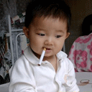
SMOKING IS INJEROUS TO OUR HEALTH

